Slide 1
PKSG Sentiment Time Series Demo
Fanchao Meng, Mark Orr

Slide 2
Why PKSG?
Phrase-based Knowledge Sentiment Graph
Need a representation for both semantics and fine-grained sentiments (as well as user relationships in social networks) on social media texts.
Short.
Not well written.
Dynamics of semantics, sentiments, user relationships and their interactions.

Slide 3


Why PKSG?
Embedding methods?
Distributional
Token? Sentence? Document?
Semantic drift? Scenario-specific?
Enough data to train? (Context-based methods, e.g. BERT, are inappropriate for semantics)
Interpretable?
Grammar-based methods?
Tree-based
Computationally expensive (e.g. have to handle full parse trees)
Difficult to adapt to various downstream tasks
Knowledge graphs?
Distributional + Tree-based?
Nodes? (Token? Sentence? Named entities?)
Relations? (Lexical? Logical? Co-occurrence? Customized? Finite?)

Slide 4
What is PKSG?
A graph-type data structure capturing semantics and sentiments.
Essential principle for Nodes: “Phrases”.
More specific than lexical terms, and more general than sentences.
Shallow syntactic relations.
Essential principle for Edges: “Co-occurrences”.
In-sentence: Common-sense context.
Cross-sentence: Specific to social media texts (e.g. tweets) .
Essential principle for Sentiments: “Constituent Sentiment Trees”.
Each internal node carries the sentiments of constituents within a certain scope.

Slide 5
A Couple of Sentiment Time Series Spoilers
Twitter Data
CA, sentiments of “vaccine”, from Jan. 31, 2020 to Nov. 26, 2020.
CA, sentiments of “mask wear”, from Jan. 31, 2020 to Nov. 26, 2020.

Slide 6
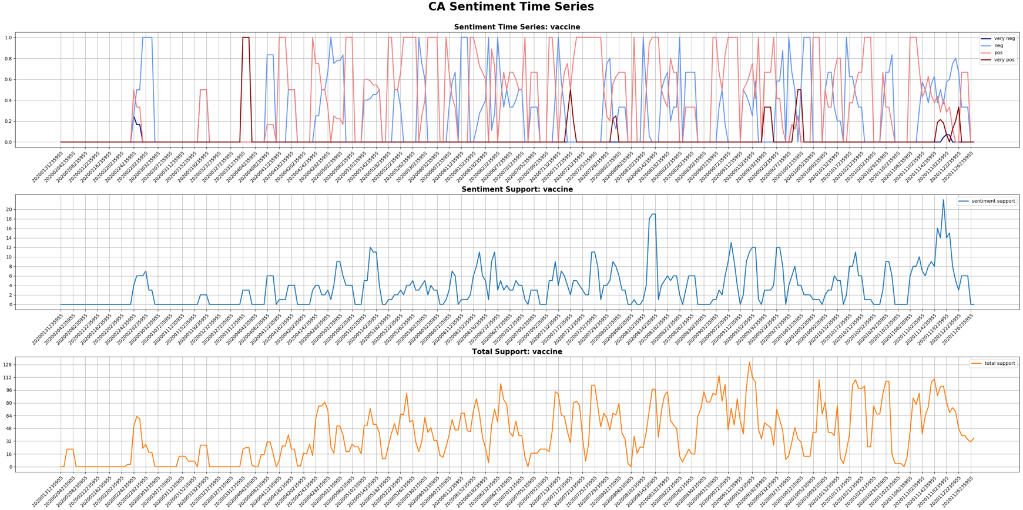

Slide 7
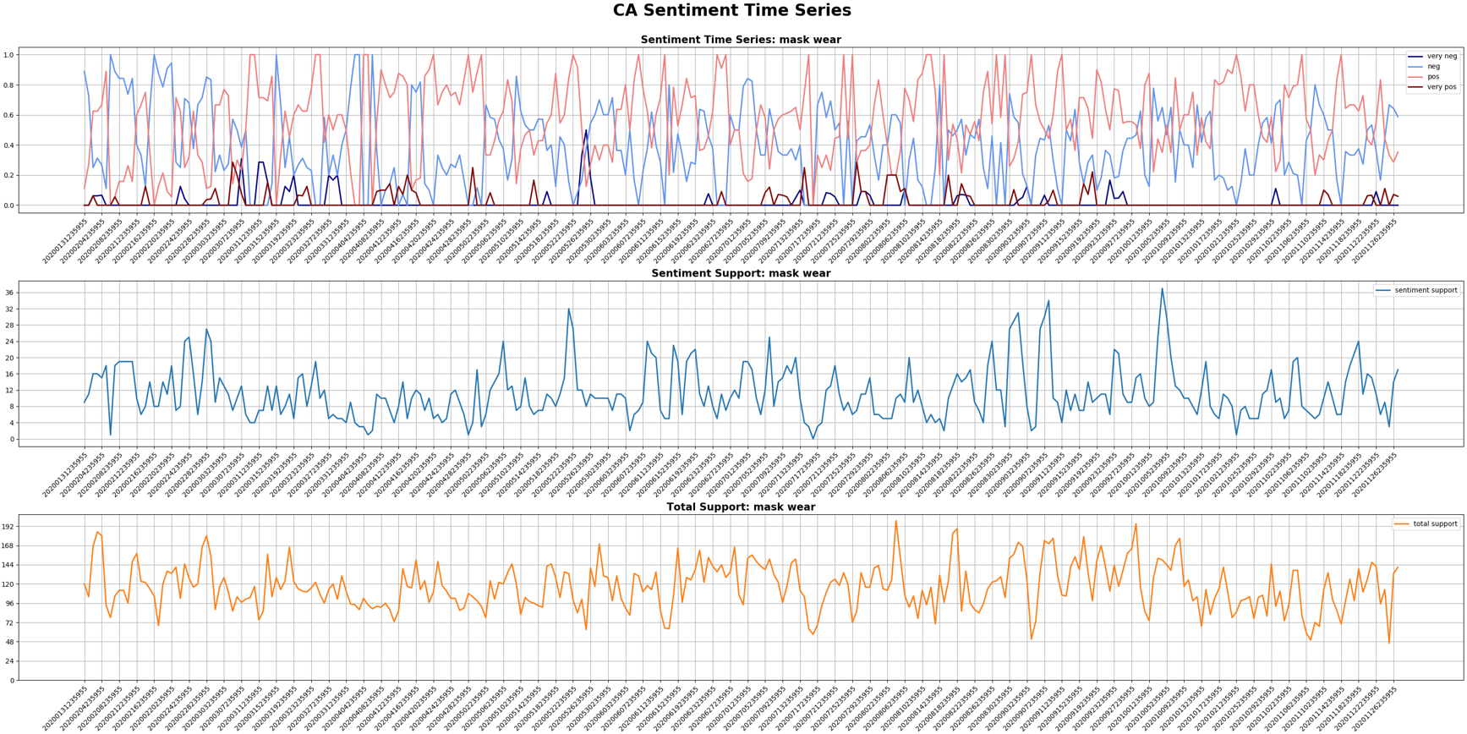

Slide 8
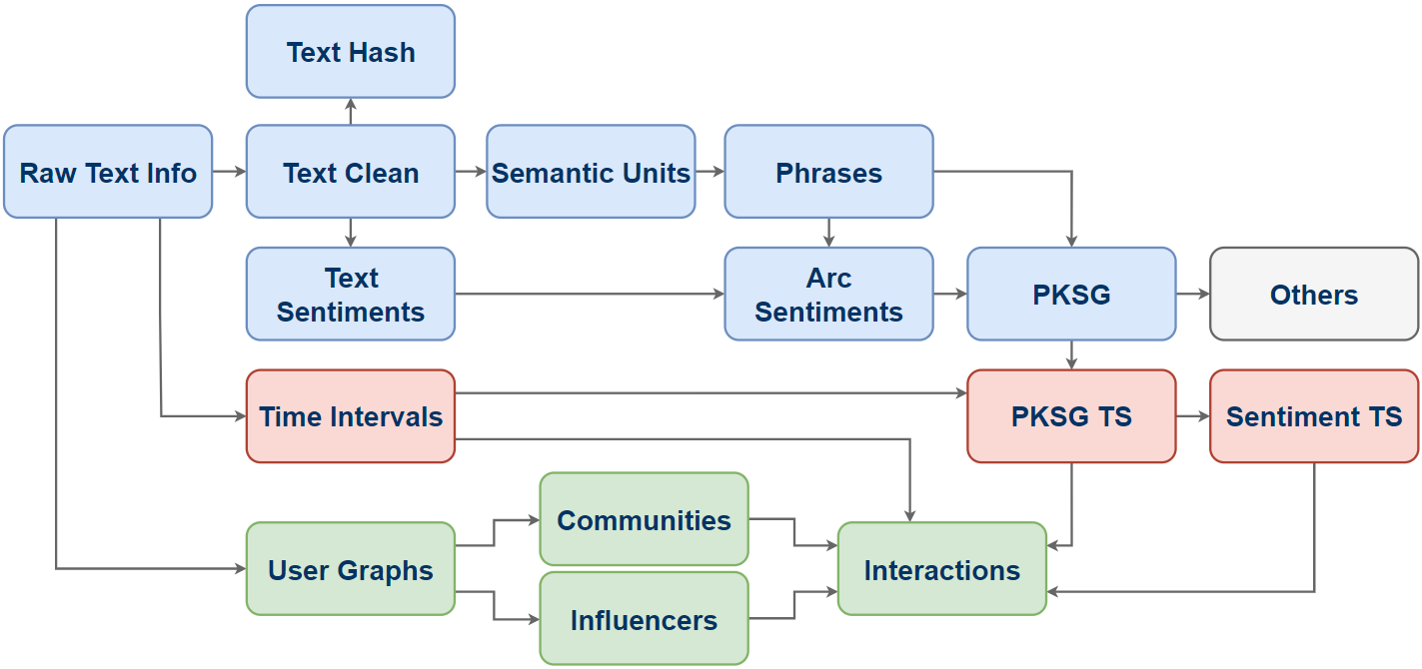
PKSG Pipeline: Overview

Slide 9
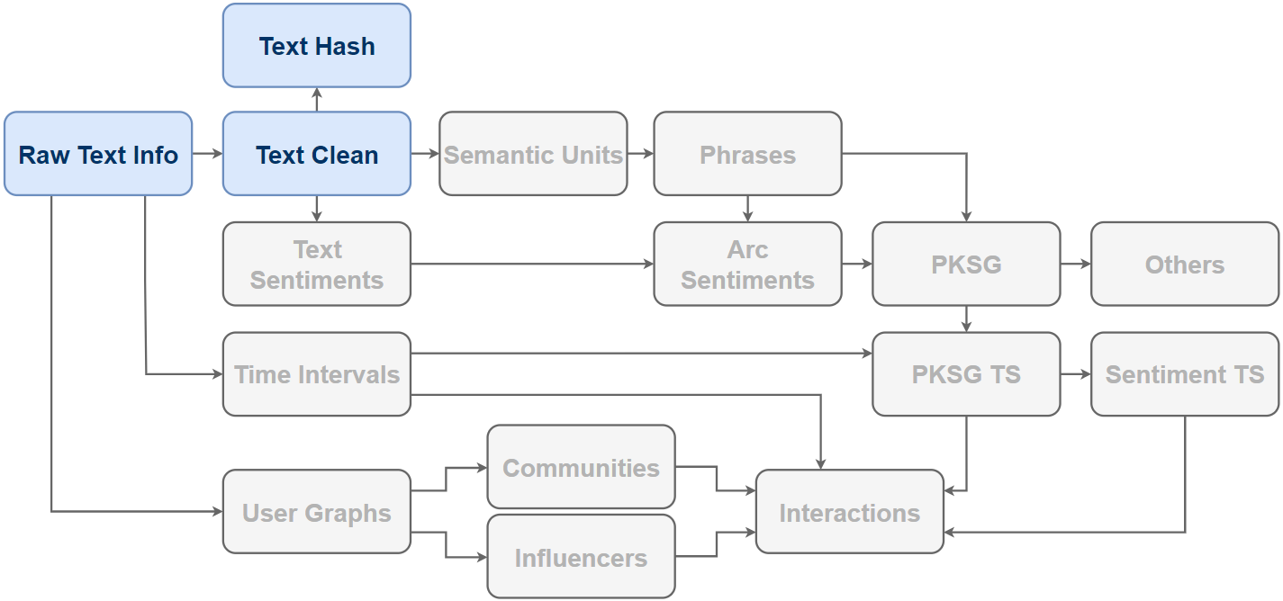
PKSG Pipeline: Overview
Text preprocessing & Indexing.

Slide 10
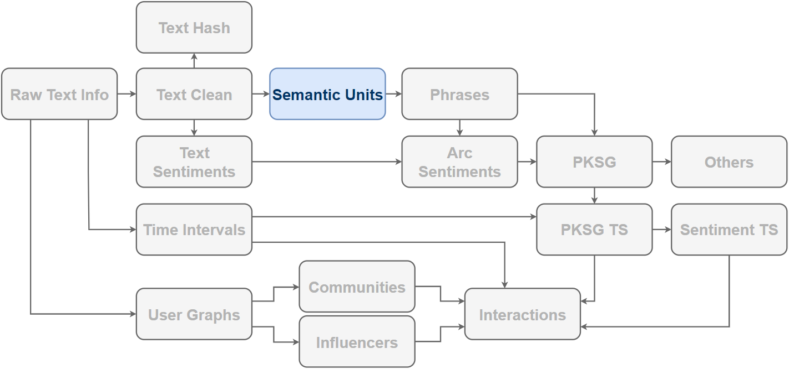
PKSG Pipeline: Overview
Simplify syntactic information as much as possible.

Slide 11
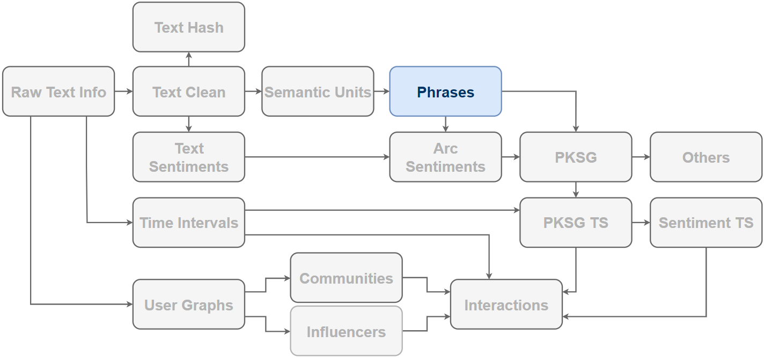
PKSG Pipeline: Overview
The most fundamental units carrying semantics and sentiments.

Slide 12
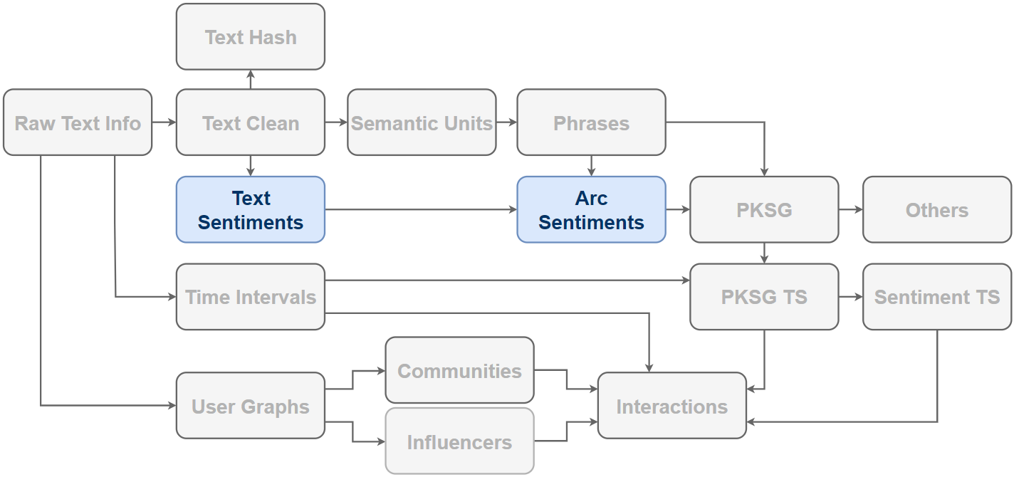
PKSG Pipeline: Overview
Phrase-based sentiments, a generalization of aspect-(entity-)based sentiments.

Slide 13
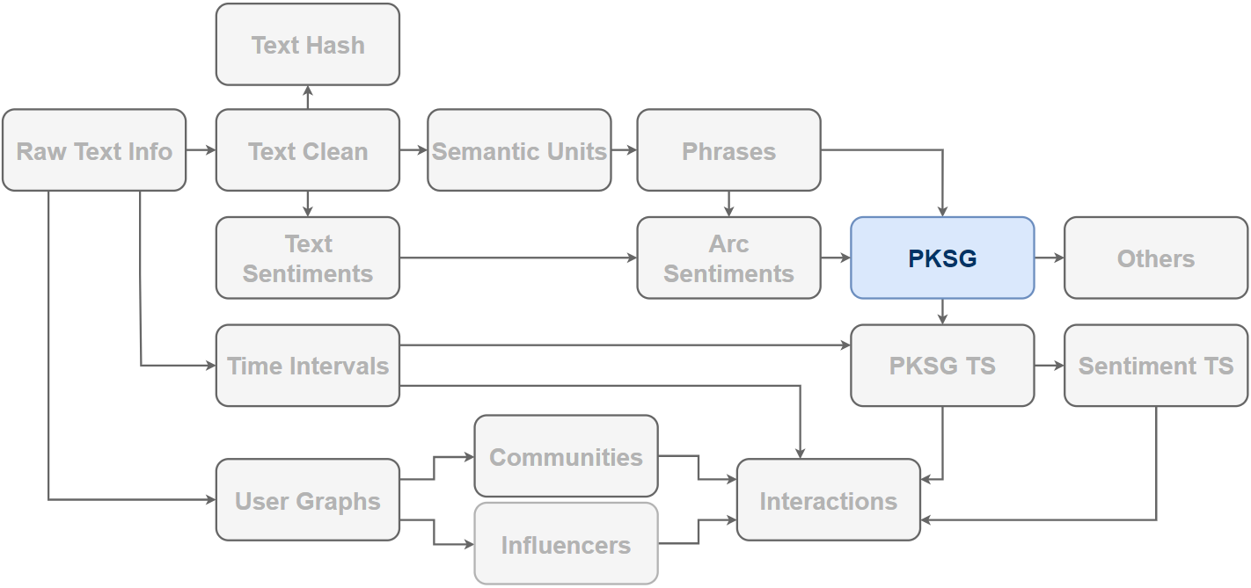
PKSG Pipeline: Overview
A graph linking phrases by co-occurrences, the desired data structure per text.

Slide 14
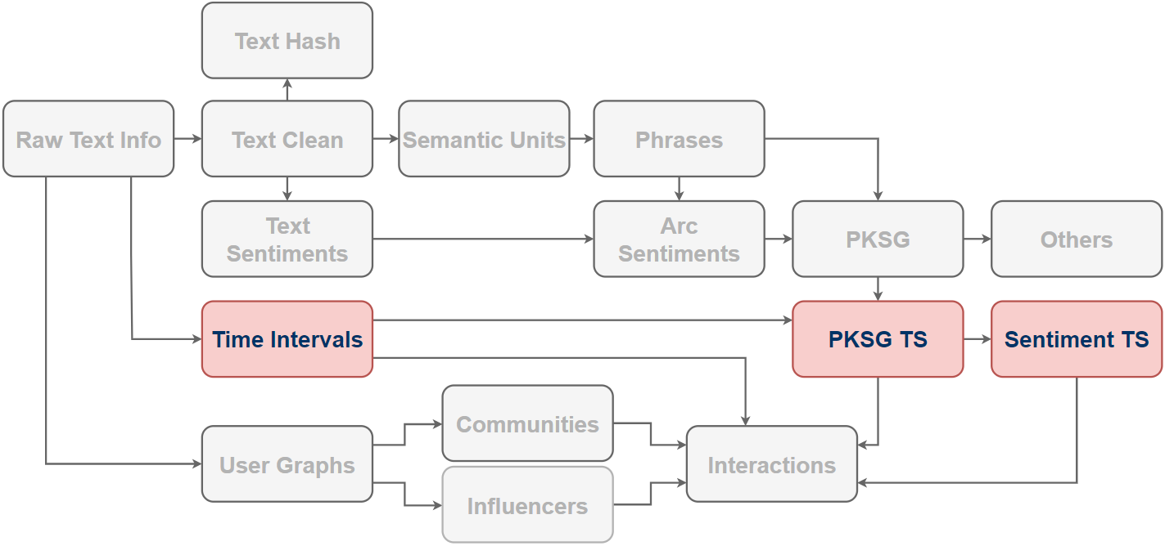
PKSG Pipeline: Overview
An aggregation of PKSG over time with a sentiment retrieval.

Slide 15
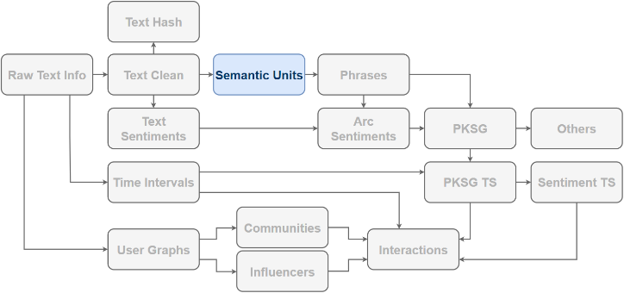
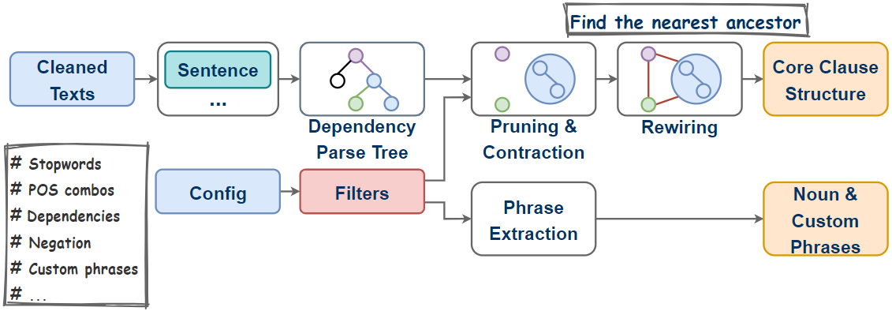
PKSG Pipeline: Semantic Units
Not the final phrases yet!

Slide 16
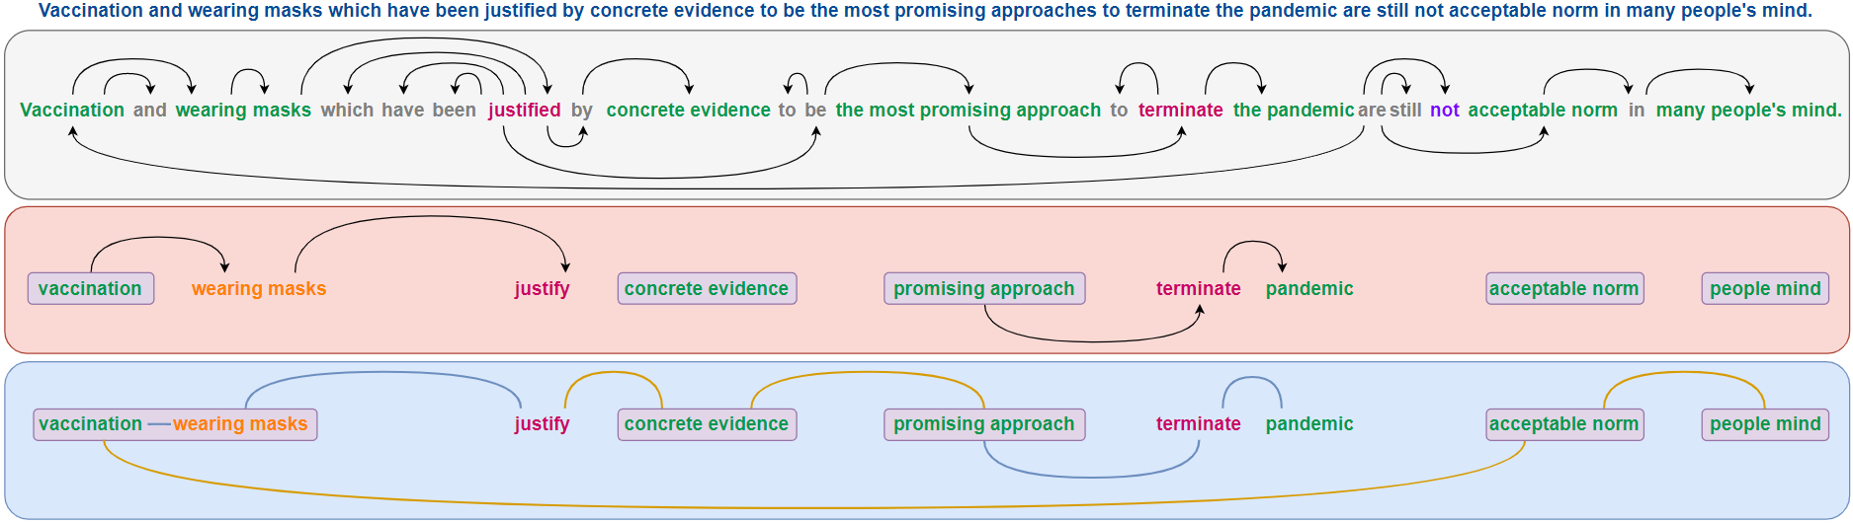
PKSG Pipeline: Semantic Units
Noun Phrases: concrete evidence, promising approach, acceptable norm, people mind
Custom Phrase: wearing masks

Slide 17
Interlude
Are the dependency parsers trustable?
Fairly well.
How is the “Filter” configured?
POS combos and dependencies can be tricky. Noisy when too loose while missing important semantics when too strict. Needs better solutions.
How is negation handled?
For sentiments exclusively, negation cues can be dropped. The sentiments will not be affected. However, dropping negation may lead to issues when focusing on semantic representations.

Slide 18

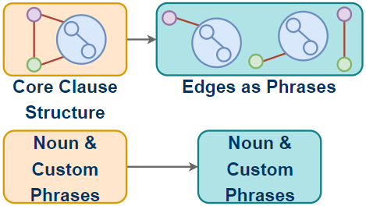
PKSG Pipeline: Phrases
Extracted Phrases:
(wearing masks)
(concrete evidence)
(promising approach)
(acceptable norm)
(people mind)
(vaccination, wearing masks)
(vaccination, justify)
(vaccination, acceptable norm)
(wearing masks, justify)
(wearing masks, acceptable norm)
(justify, concrete evidence)
(concrete evidence, promising approach)
(promising approach, terminate)
(terminate, pandemic)
(acceptable norm, people mind)

Slide 19
Interlude
How is this different from terminology extraction and text summarization?
Terminology extraction concentrates on terms highly relevant to a topic, usually noun phrases. Text summarization keeps the most important constituents and/or substitutes long utterances to shorter ones in very similar meanings. We focuses on the semantic fragments carrying the most important semantics without specific topics and reorganizing the texts.
How do you know the phrases are all important?
It is a subtle question. Rigorously, we don’t. This problem is essentially the same as asking what the Self-Attention mechanism is offering without specifying downstream tasks.
(Does BERT suck?)

Slide 20
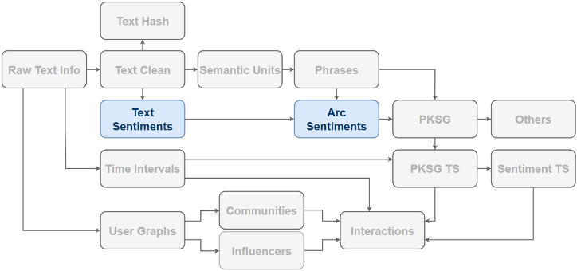
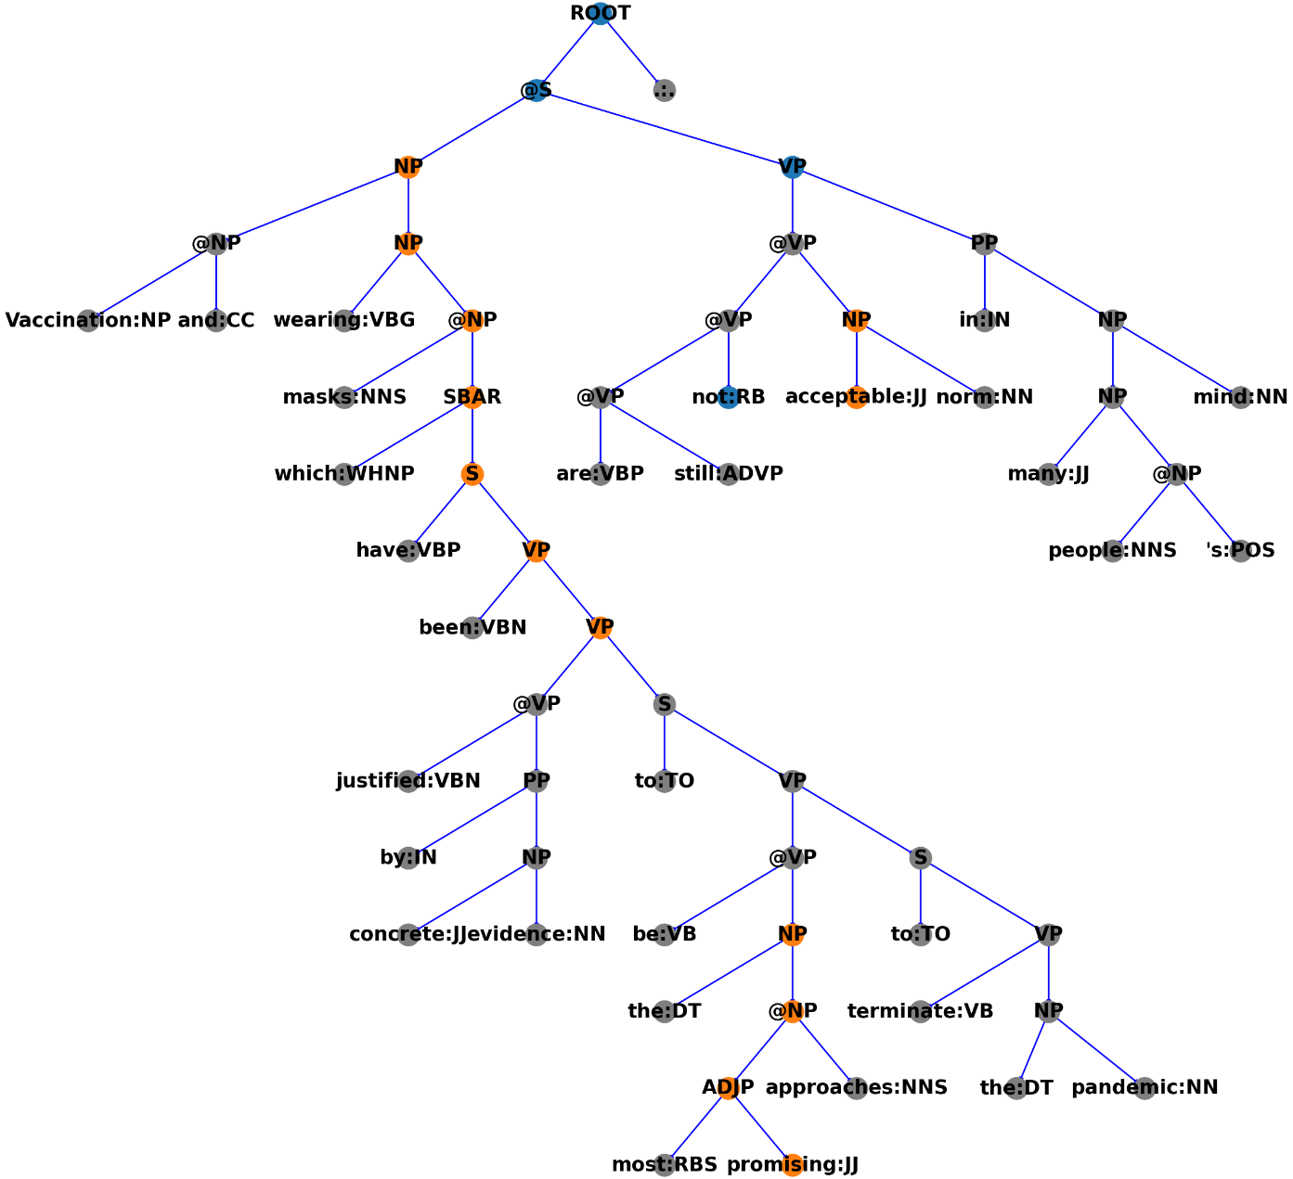
PKSG Pipeline: Text Sentiments
Stanford RNTN Sentiment Model
Constituent Sentiment Tree
Binary
Constituent-level sentiments
Lexicon for leaves
RNTN for internal nodes
Bottom-to-up inference
Stanford Sentiment Treebank
Negative
Positive
Neutral

Slide 21
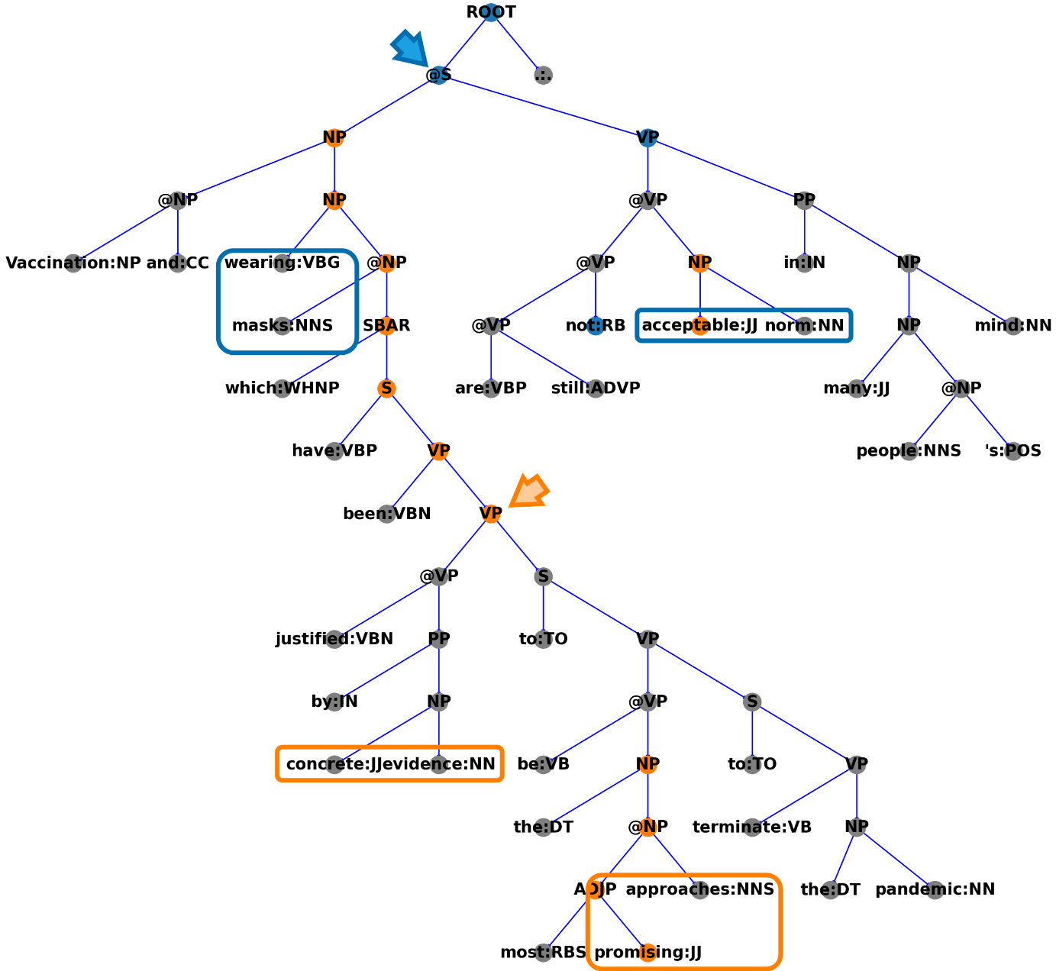
PKSG Pipeline: Arc Sentiments
Arc
Formed by two phrases
Shallow syntactic info + Co-occurrences
Sentiments on Min Root
Find the min subtree containing the arc
Take the sentiments at the root
Context Matters!
The arc
[wearing masks + acceptable norm]
is negative in this example
Can be easily positive in some other sentences, e.g.
“Wearing masks is an acceptable norm.”
Negative
Positive
Neutral

Slide 22
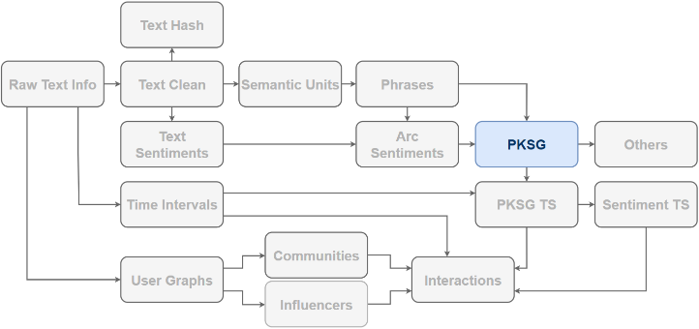
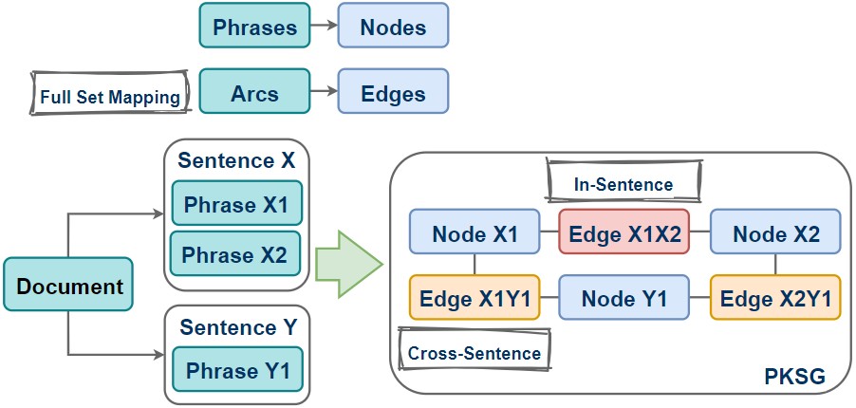
PKSG Pipeline: PKSG
Node
Lemmas
POS
Spans
Occurrences
Doc IDs
Edge
Sentiments
Co-occurrences
Phrase IDs
In-Sentence vs Cross-Sentence
In-Sentence: Arc Sentiments
Cross-Sentence: No Sentiments
Notes:
Why mapping the full set of arcs to edges?

Slide 23
Interlude
Regarding detecting sentiments on “phrases”, why not the following idea?
Argument Structure Analysis
Sentence-level Sentiments
Apply sentiments to detected objects/subjects
Issues
Sensitive to the accuracy of argument structure analysis, especially on texts not well-written.
Sentence-level Sentiments may not reflect actual sentiments on fine-grained objects (e.g. controversial).

Slide 24
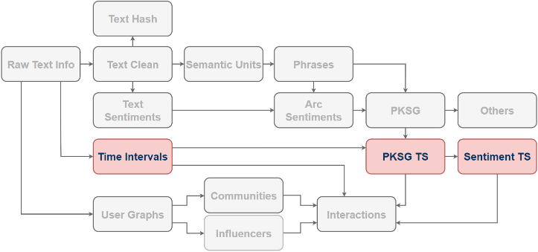
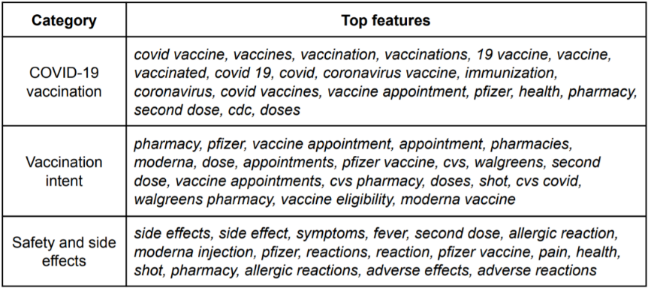
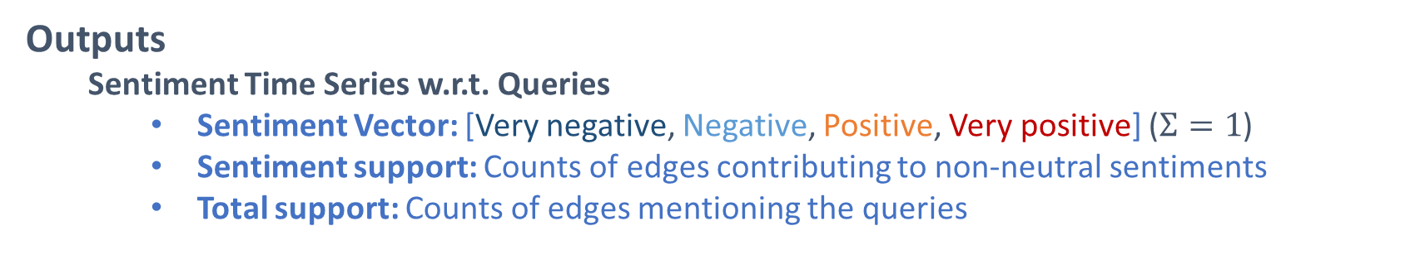
Sentiment Time Series
Inputs
Twitter data
Geo-Projection: If geo-info is available, e.g. CA, NY, FL and PA.
Queries
Inflectional morphology: E.g. {mask wear, mask wearing, wear mask, wearing mask, wearing masks}
Quotient
Time Series
Stride: E.g. 1 day
Span: E.g. 3 days
Outputs
Sentiment Time Series w.r.t. Queries
Sentiment Vector: [Very negative, Negative, Positive, Very positive] ($Σ=1$)
Sentiment support: Counts of edges contributing to non-neutral sentiments
Total support: Counts of edges mentioning the queries

Slide 25
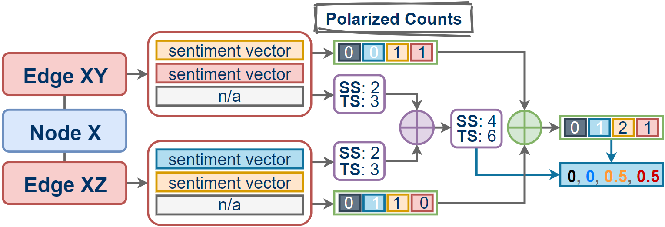
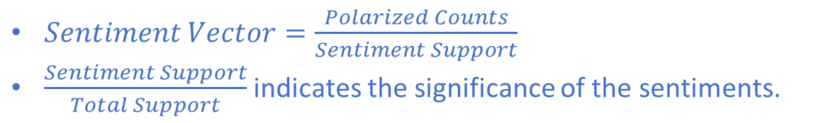
Sentiment Time Series
SS: Sentiment Support
TS: Total Support
Polarized Counting
$Sentiment Vector=\frac{Polarized Counts}{Sentiment Support}$
$\frac{Sentiment Support}{Total Support}$ indicates the significance of the sentiments.

Slide 26
Interlude
How do “stride” and “span” in time series affect the results?
Events happen. Skipping days may result in missing salient ones.
Given the timeline being fully covered, the larger the stride, the more general the sentiment trend.
Roughly, a surge caused by an event lasts for a couple of days. Mostly, short spans are fair if the stride is not too large.
Why is “neutral” not considered in the sentiment vector?
Neutral texts are dominant.
The significance of sentiments matters!

Slide 27
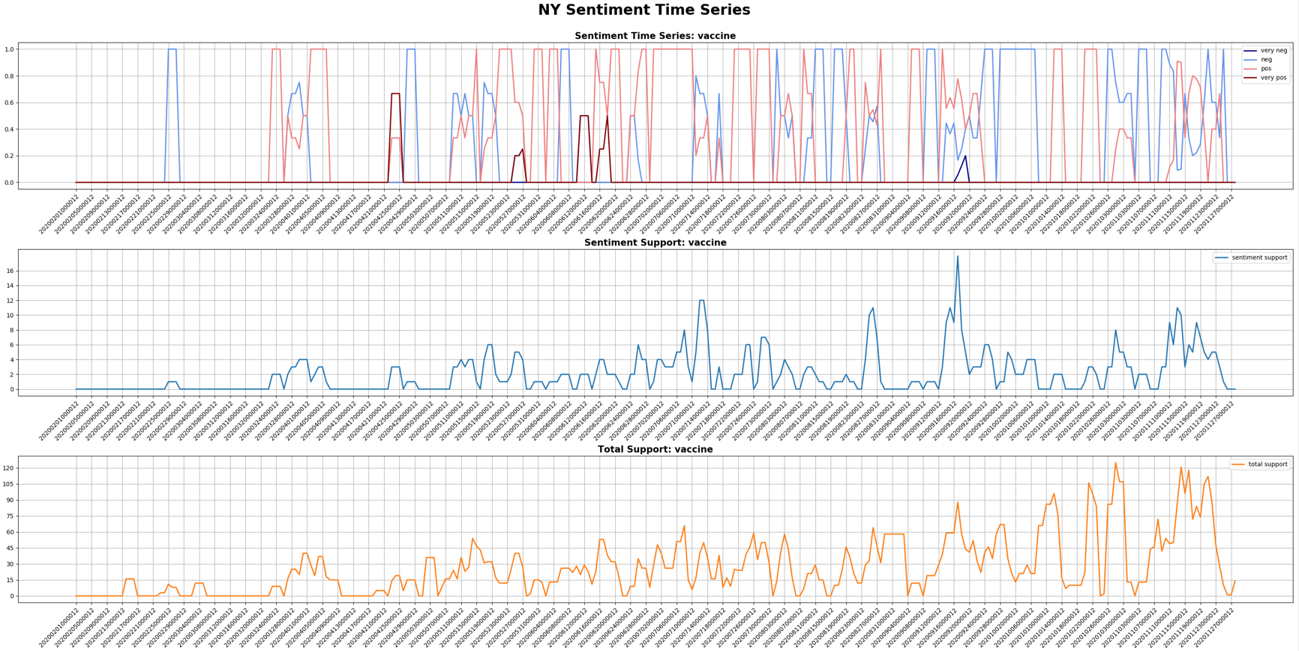

Slide 28
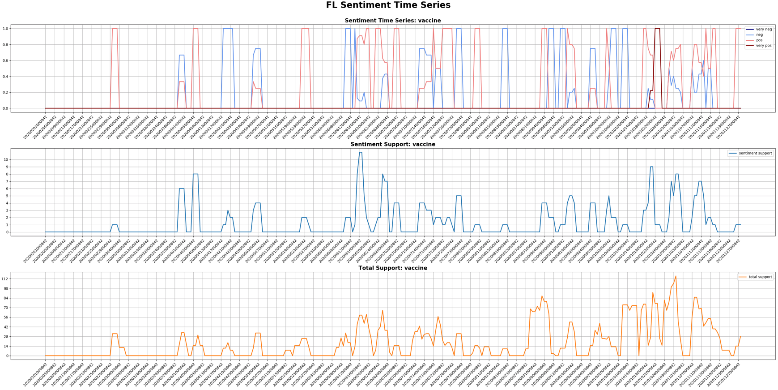

Slide 29
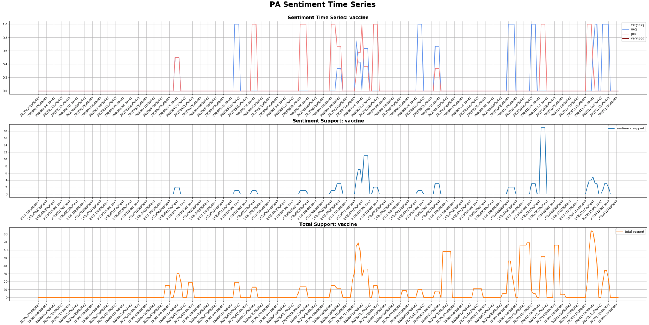

Slide 30
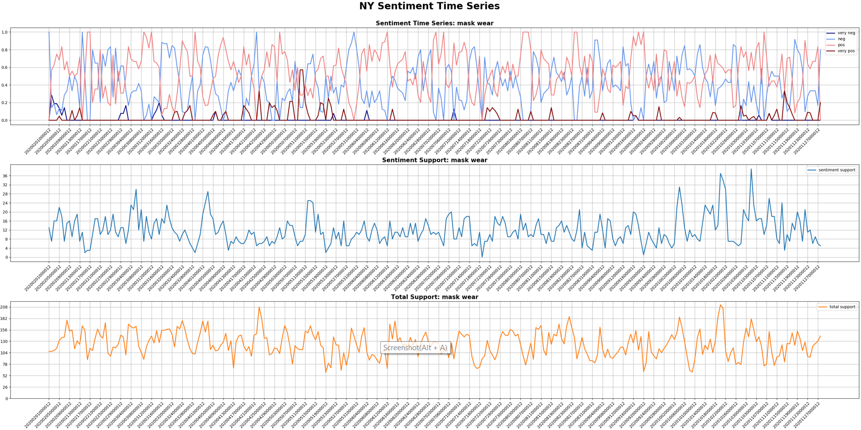

Slide 31
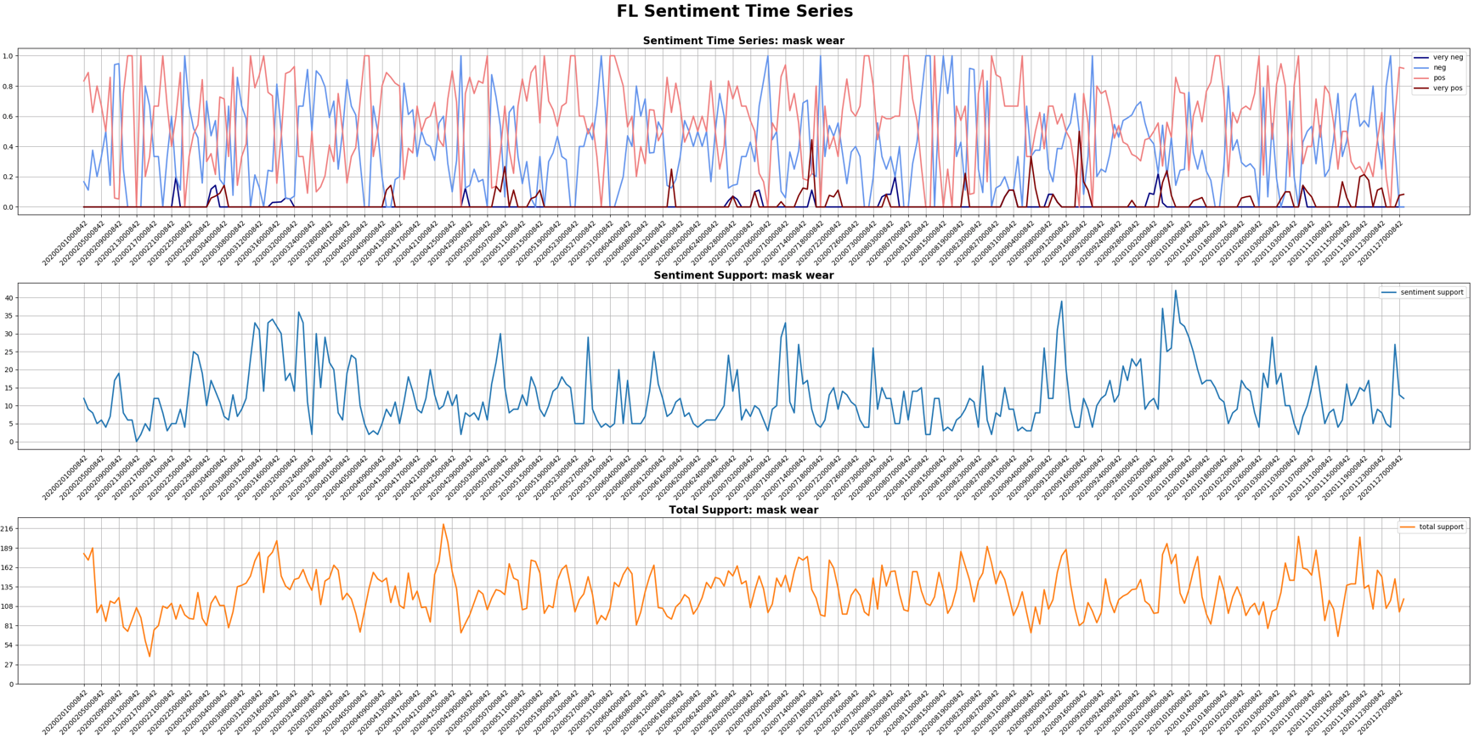

Slide 32
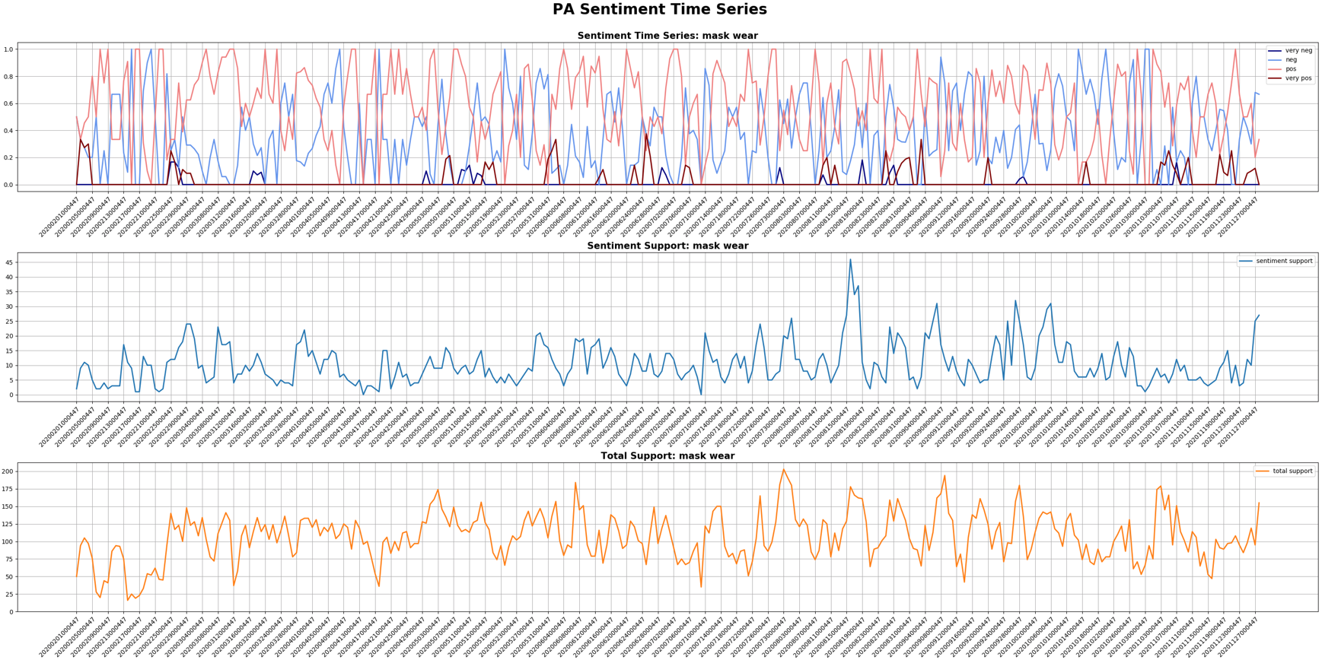

Slide 33
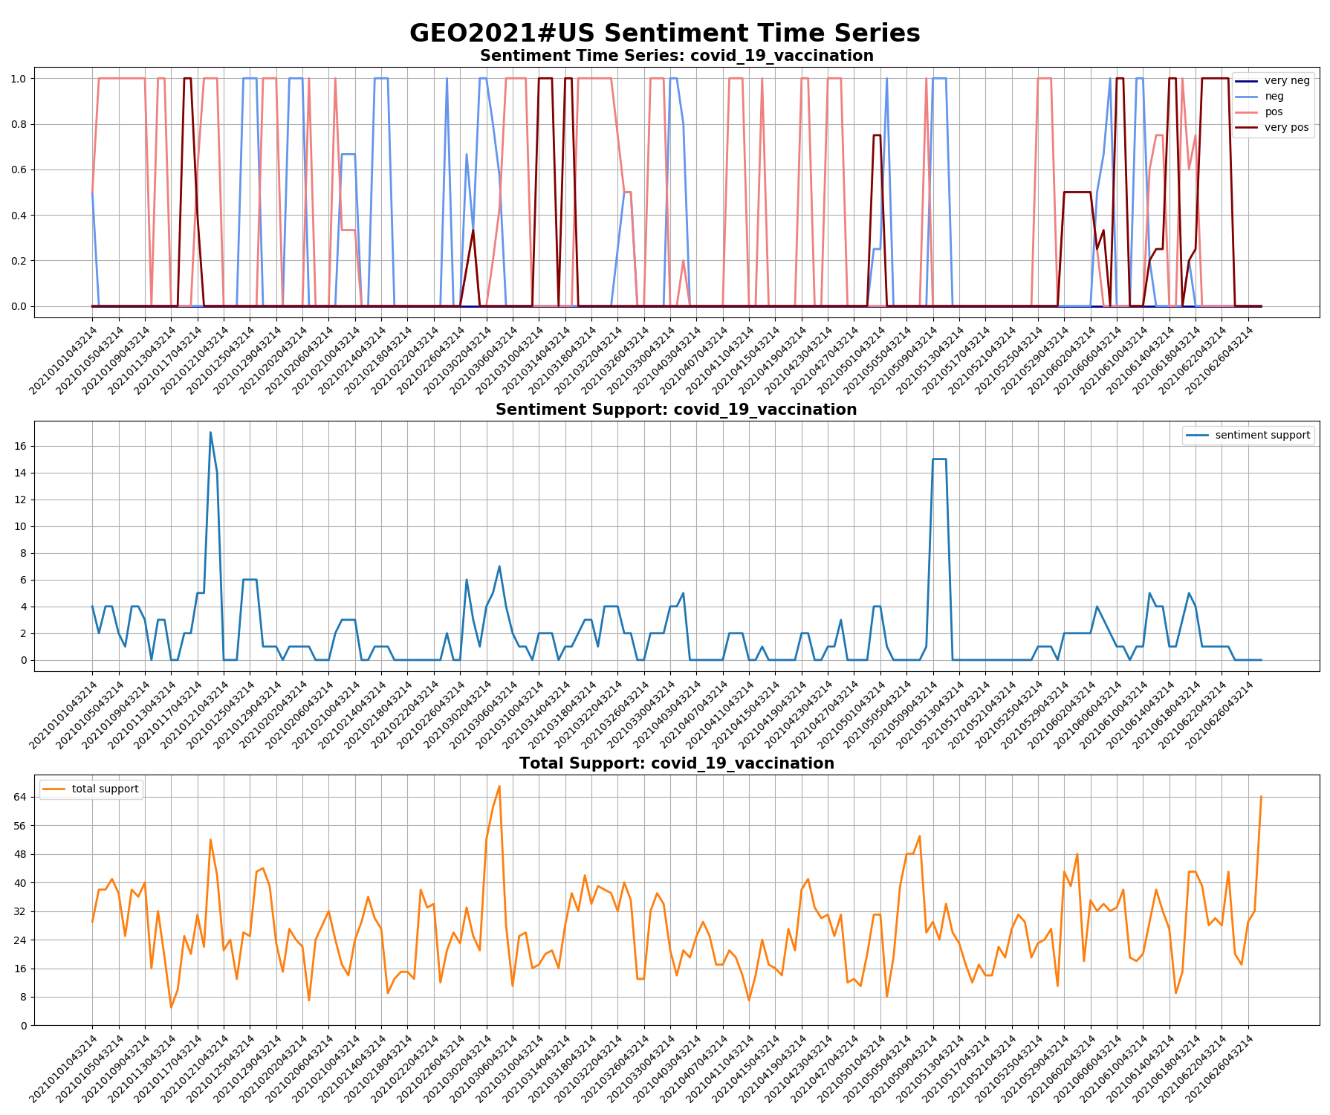

Slide 34
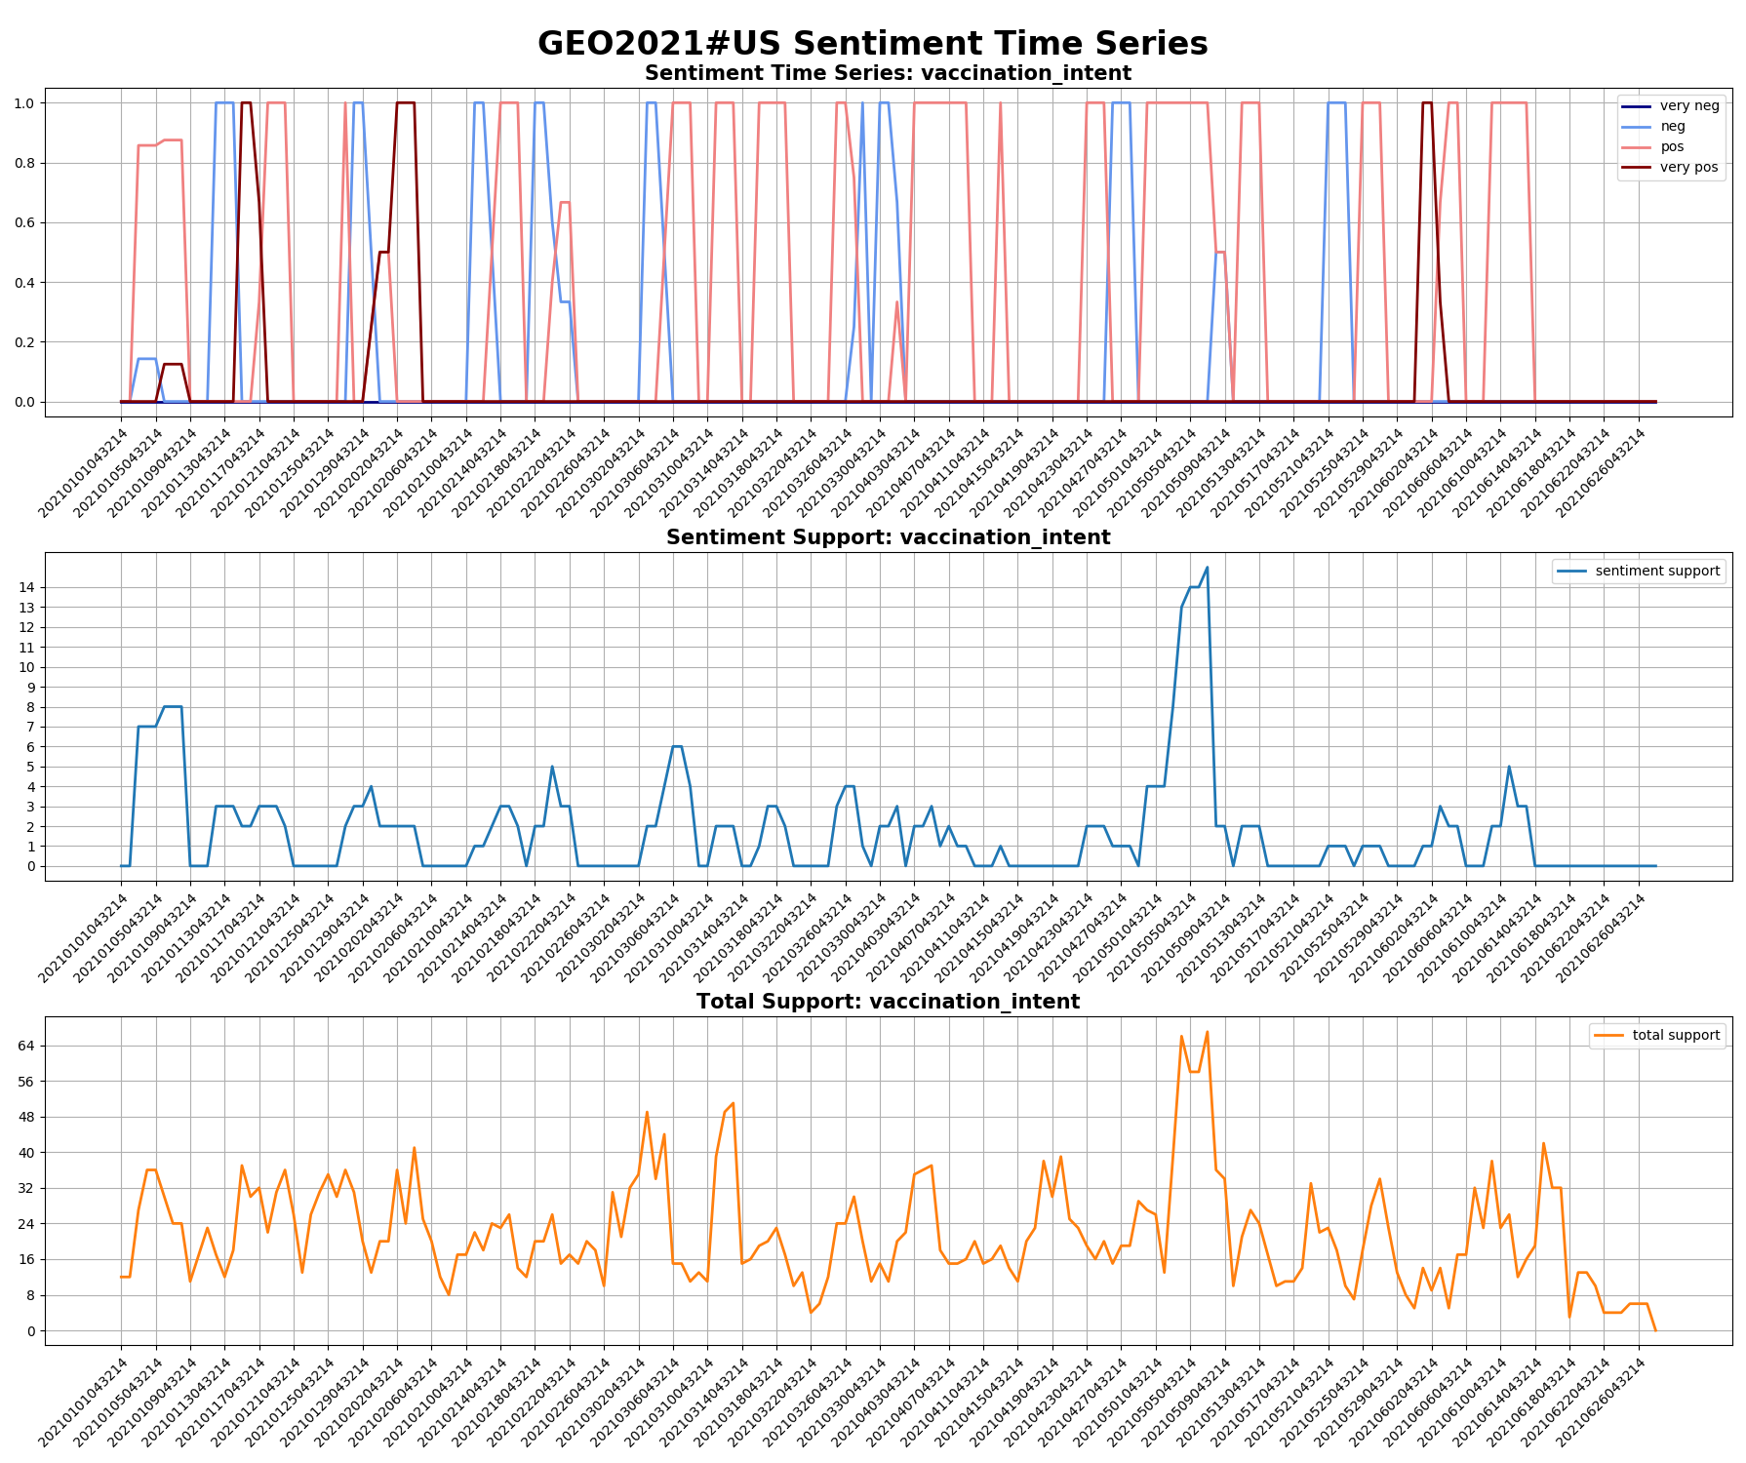

Slide 35
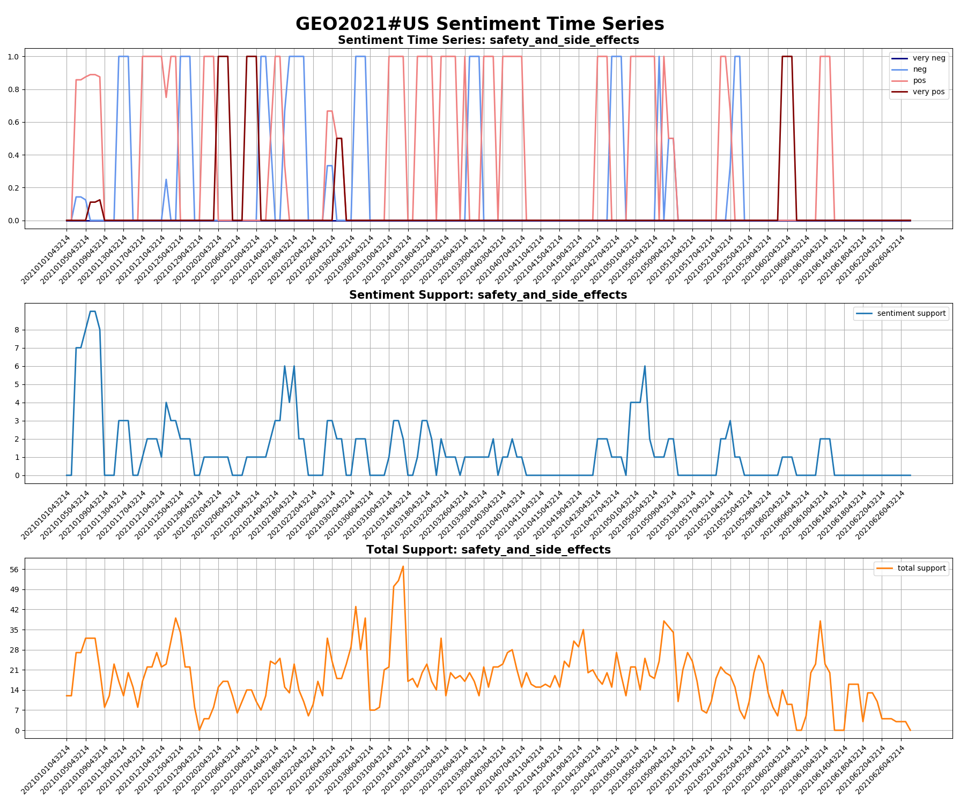

Slide 36
Interlude
How you evaluate PKSG?
Informal testing, YES. Formal testing, ongoing, (e.g. aspect-based sentiment analysis).
How long will it take to have sentiment TS for a whole month Twitter data?
Depends on the size of data. Roughly, a couple of days for <100GB data with 10 nodes.

Slide 37
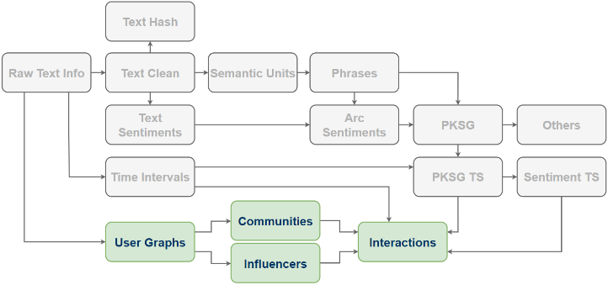
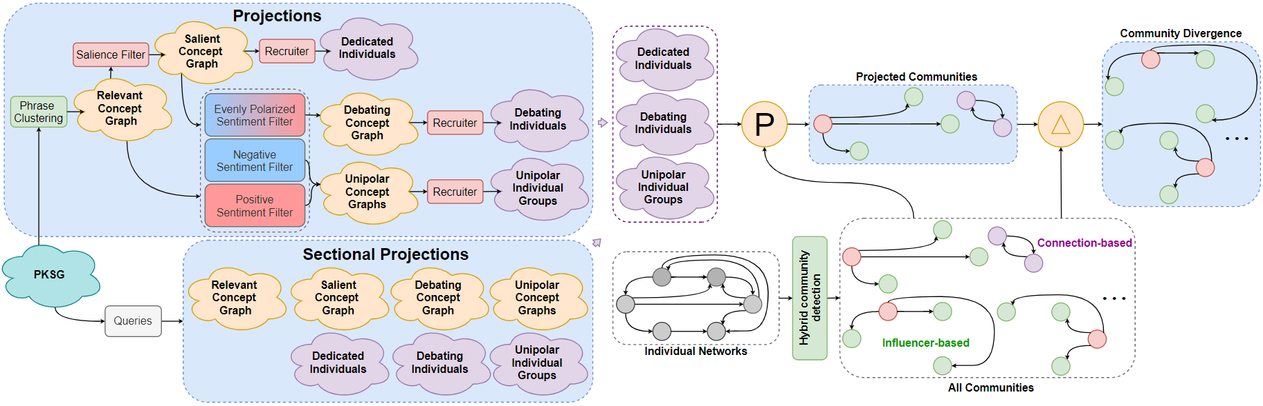
User Projections
Retweeting Graphs
Belief propagation (people who have similar beliefs aggregate)
Graph Patterns w.r.t. Beliefs
Influencers determine dynamics of beliefs?
Dynamics of beliefs determine communities?

Slide 38
What Next?
User Projections: Modularity-based, Influencer-based…
Semantics-Community Interactions: Static analysis, Time series forecasting…
Socio-cognitive: Link to ACT-R?

